Slide 1
Automatic Text Summarization Using Reinforcement Learning
Ali Emami & Yue Dong

Slide 2
Motivation & Intro
The problem of automatic text summarization
A growing need to summarize single or multiple documents
Human summaries very costly
NLP applications
Extractive approach
Previous extractive methods:
Maximal marginal relevance (MMR)
Global inference algorithms using integer linear programming (IPL)
Automatic summarization using reinforcement learning (ASRL) [Ryang and Abekawa, 2012]
Re-implementation & exploring with policy gradient methods
Notes:
-Extractive approach to automatic summarization is a popular and well-known approach in this field, creates a summary by directly selecting some textual units (either, characters, words, clauses, or sentences) from the original documents, because it is difficult to genuinely evaluate and guarantee the linguistic quality of the produced summary.
-Maximal marginal relevance cores each textual unit and extracts the unit that has the highest score in terms of the MMR criteria. Greedy MMR-style algorithms are widely used; however, they cannot take into account the whole quality of the summary due to their greediness, although a summary should convey all the information in a given document.
-Recent years have introduced global inference algorithms for the extractive approach, to consider whether the summary is “good” as a whole. Formulate the problem as an integer linear programming to optimize the score: however, as ILP is NP-hard, time complexity is very hard.
-need for more efficient algorithms
-Recently [2012] the problem has been attempted within the framework of the RL framework, optimizing the given score function with given feature representation of a summary.

Slide 3
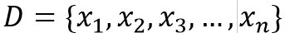
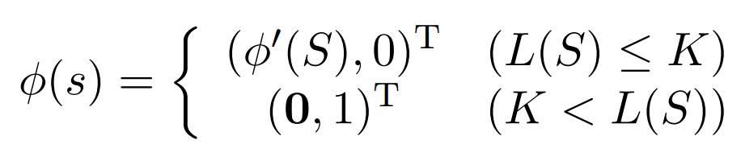
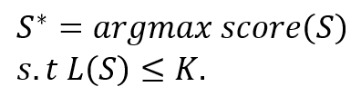
Formulation
State:
A state denotes a summary. Each state s is represented as a tuple s = (S,A,f), where A is a history of actions, and f ∈ (0,1) a binary state variable denoting whether s is a terminal state or not. Initial state s₀ is (∅,∅,0)
d-dimensional feature representation, ϕ(s) ∈ R^{d} , of state s assumed, based only on feature of summary, ϕ’(s) ∈ ℝ^{d-1}:
ϕ’(s) should be designed with care, and should include:
• Coverage of important words • Coverage ratio
• Redundancy ratio • Length Ratio • Length
Problem:
A given document is reduced to the set of textual units:
where n is the size of the set, and x_{i} denotes individual textual units.
Given the score function score(S), and length function L(S), for summary S ⊂ D, and length limitation K, the automatic summarization problem can be formulated as:
Notes:
“Note that feature of the state only depend on the features of the summary, not on the executed actions to achieve the state. This property has the potential
For different states to be represented as the same vector, which has the same features. Agent should search as many possible states as it can. Therefore, the generalization function of the feature representation is of utmost importance”.

Slide 4
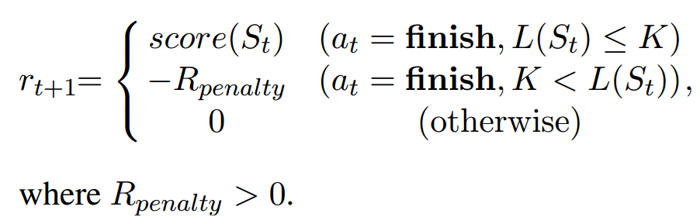
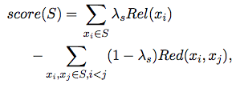
Reward
Agent receives a reward from the environment as criterion for how good the action executed is.
Agent receives score by the score function if and only if the executed action is finish and summary length is appropriate
If summary length is inappropriate and the action is finish, the agent receives a large penalty
Delayed reward
For current state s_{t} and action a_{t}, and the agent transitions to s_{t+1}:

Slide 5
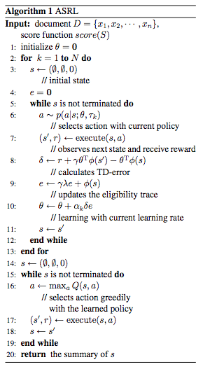
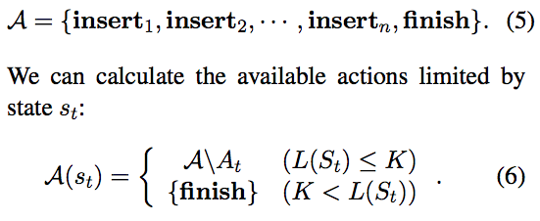

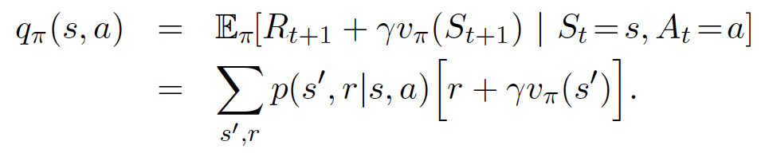


Ryang&Takeshi (2012)

Slide 6
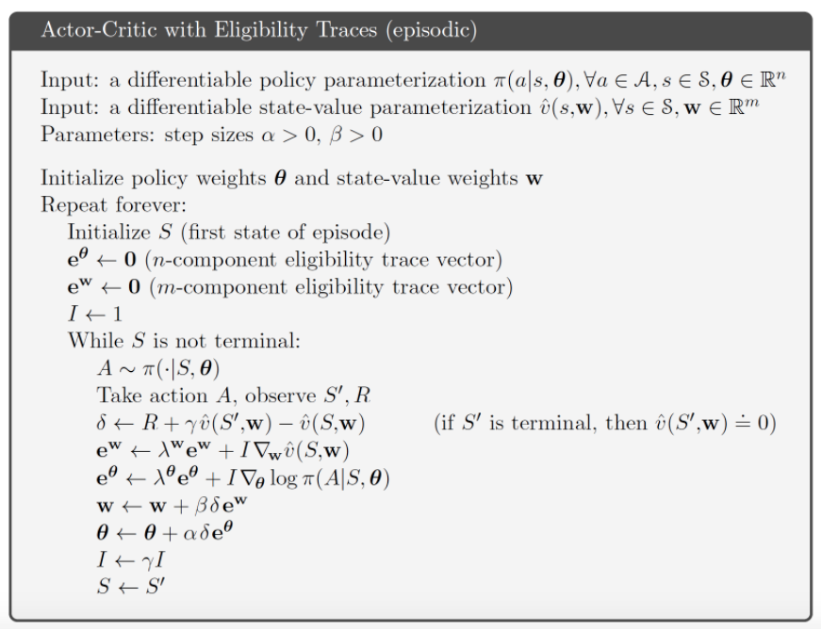
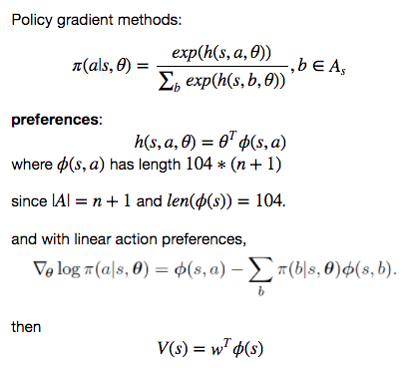
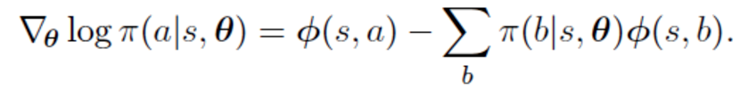
Our Ideas
Try different lambda
Using policy gradient method
Which can both achieved by actor-critic
Maybe change the reward function (or score function) since repeated selection need to be penalized.

Slide 7
Reference
Ryang, Seonggi, and Takeshi Abekawa. "Framework of automatic text summarization using reinforcement learning." Proceedings of the 2012 Joint Conference on Empirical Methods in Natural Language Processing and Computational Natural Language Learning. Association for Computational Linguistics, 2012.
Rioux, Cody, Sadid A. Hasan, and Yllias Chali. "Fear the REAPER: A System for Automatic Multi-Document Summarization with Reinforcement Learning." EMNLP. 2014.
3. Chali, Yllias, Sadid A. Hasan, and Mustapha Mojahid. "A reinforcement learning formulation to the complex question answering problem." Information Processing & Management 51.3 (2015): 252-272.

